Slide 1
Coulomb’s Law and Electric Field Strength

Slide 2
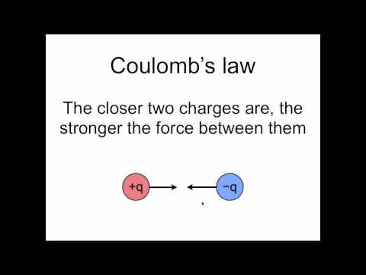
Now we can take a more mathematical look at electric fields and start putting some numbers on them. We have seen that electric fields apply forces to charged particles, but how do we work out the size of those forces? This video has the answer!

Slide 3

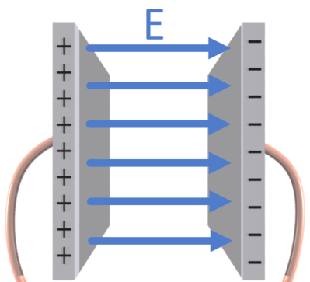
When we know how much force is acting on a charge, we can say something about how strong the electric field is. Electric field strength (E) or field density is given by the amount of force (F) acting on a particle divided by its charge (q).
The value of E is not constant in the electric field around a proton or electron. This is because such fields are radial and spread out in all directions.
However, in a uniform field where all the lines are parallel and evenly spaced, E is the same at every point in the field. You get uniform electric fields by taking two conducting plates and connecting them to the terminals of a battery. One plate becomes positively charged and the other negatively charged, so an electric field is set up.

